Slide 1
Mental Health Meme Classification
GROUP-19, NLP::2025::WinterSemester

Slide 2
Problem Statement
Social media has transformed emotional expression, especially among younger users.
Memes have become a unique medium for sharing mental health struggles (e.g., anxiety, depression).
Humorous yet emotionally charged memes reveal insights into the collective online psyche.
Subtle, ambiguous language in memes challenges traditional NLP and computer vision models.
This project explores multimodal analysis (text + image) for classifying mental health symptoms.
Focus: Depression and Anxiety detection through meme-based content.
*Referred From: Abdullah Mazhar, Zuhair hasan shaik, Aseem Srivastava, Polly Ruhnke, Lavanya Vaddavalli, Sri Keshav Katragadda, Shweta Yadav, & Md Shad Akhtar. (2025). Figurative-cum-Commonsense Knowledge Infusion for Multimodal Mental Health Meme Classification.
Project source code, architecture and training methodology has been majorly referred from the above described paper.

Slide 3
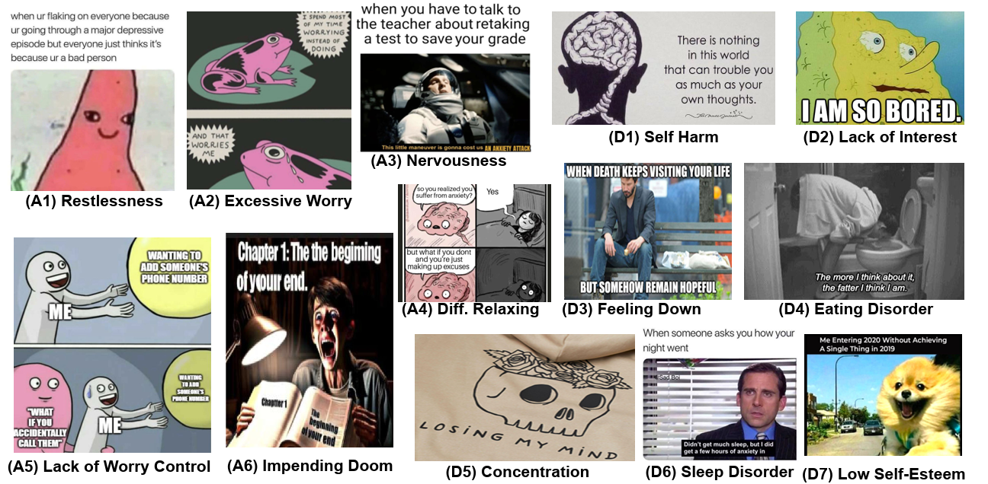
Dataset Description & Preprocessing
Depression (RESTORE): 8 fine-grained labels from PHQ-9 (e.g., Self-Harm, Lack of Interest, Feeling Down).
Anxiety (AxiOM): 8 fine-grained labels from GAD (e.g., Nervousness, Excessive Worry, Restlessness).
Text extracted from memes using EasyOCR.
Structured knowledge (Figurative) extracted using Qwen-VL (Cause-Effect, Figurative Meaning, Mental State) — appended to OCR JSON.
Visual features extracted using Detectron2 (Region features + OCR text context).

Slide 4
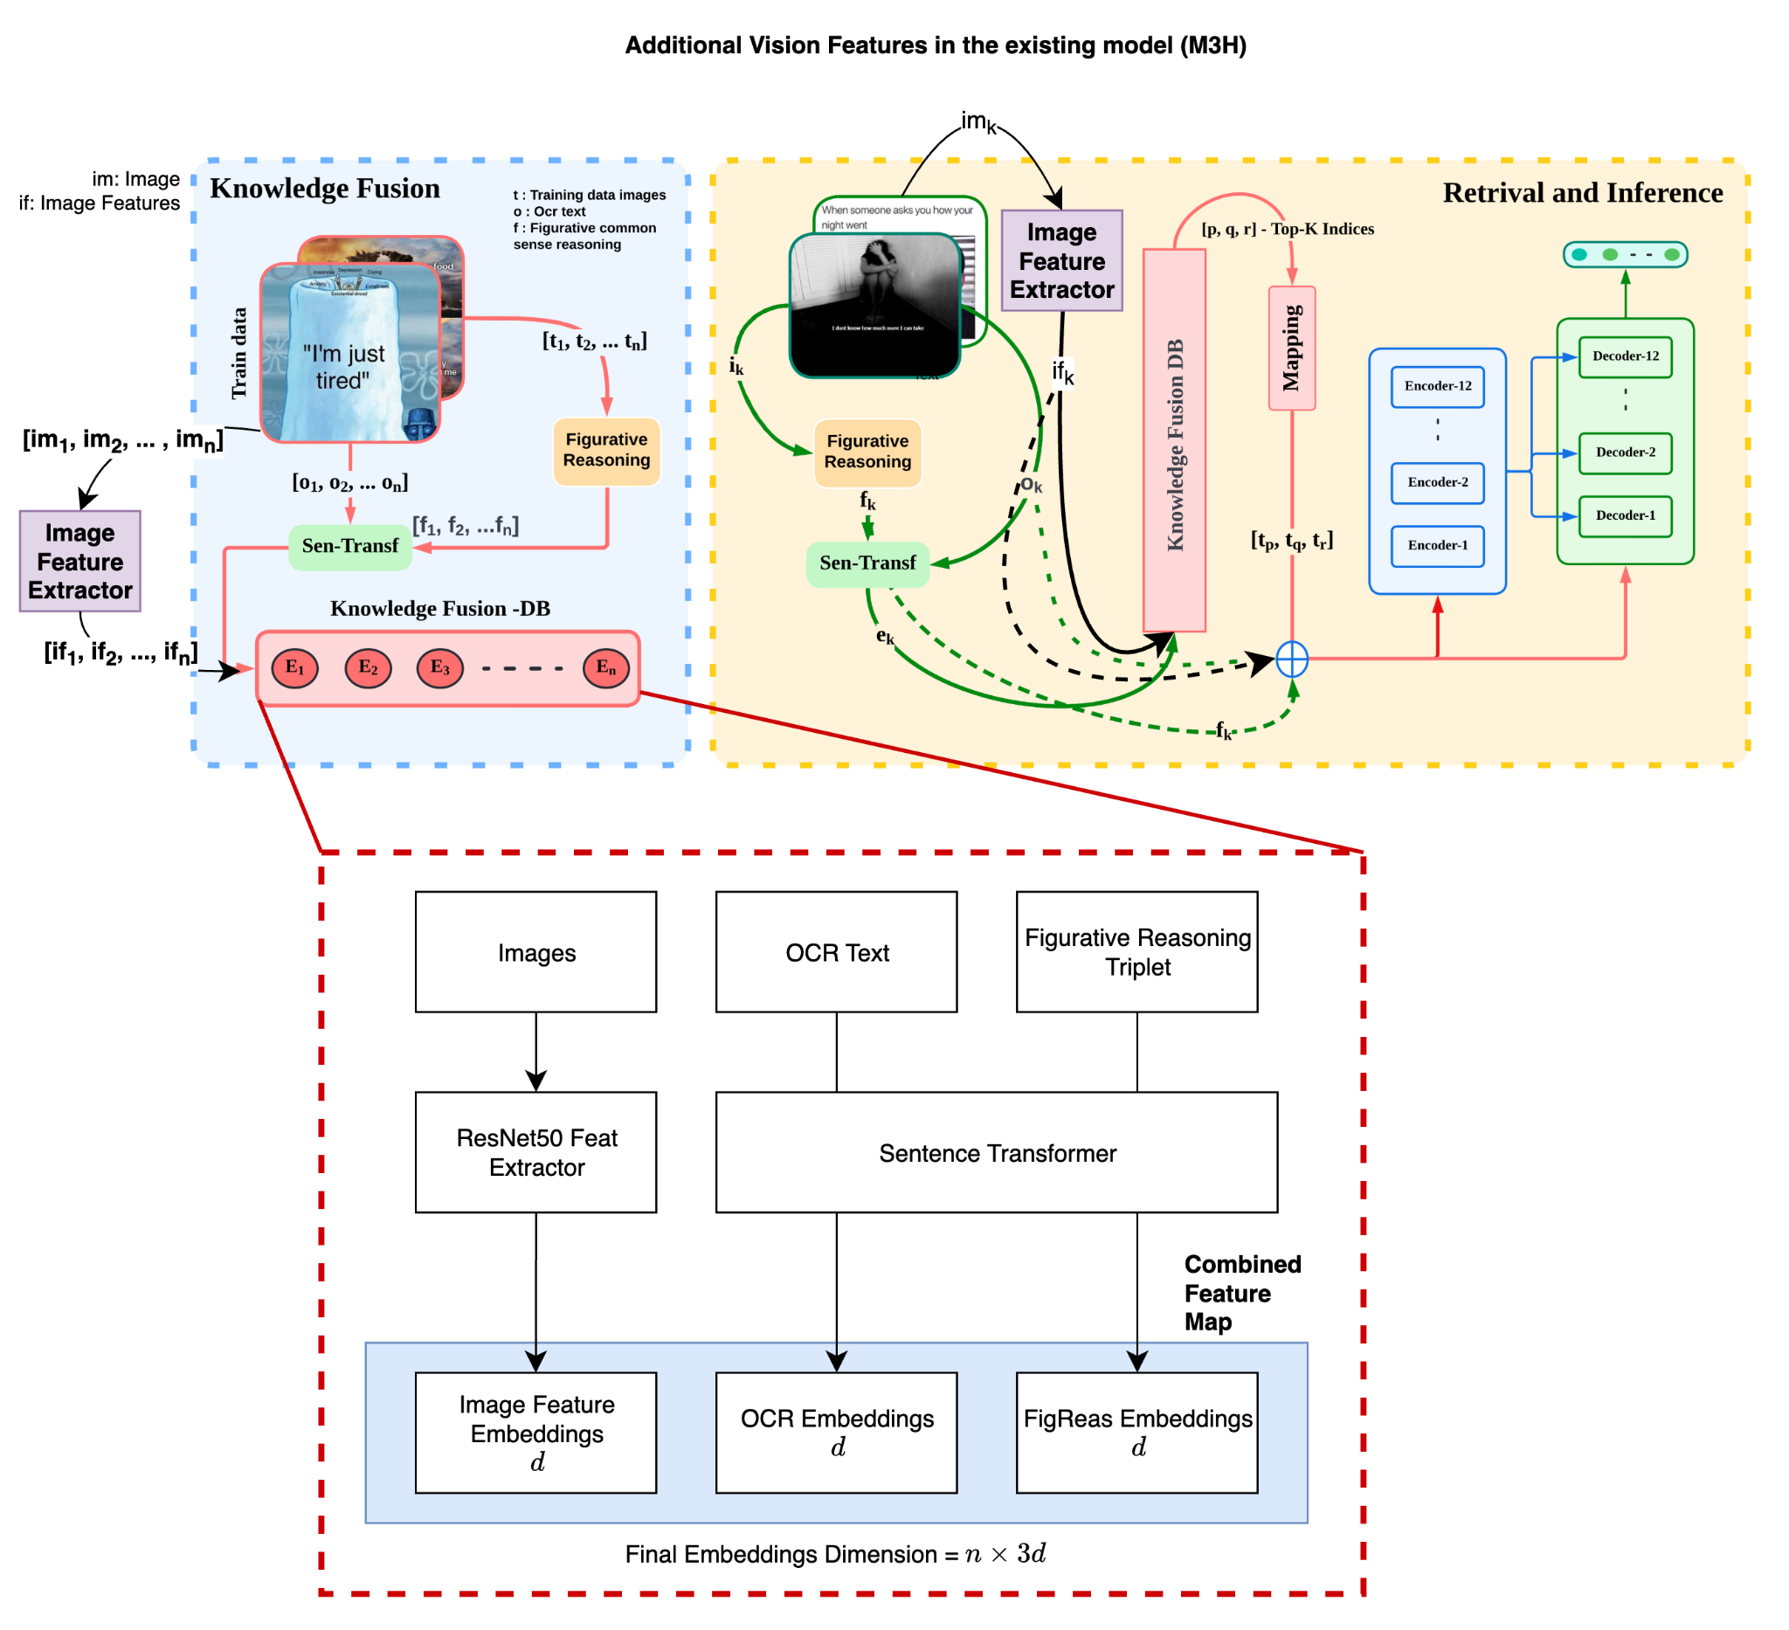
Knowledge Fusion with Enhanced Visual Features
Triple-Stream Architecture: Our approach combines visual features, OCR text, and figurative reasoning for holistic analysis
Image Feature Extraction: Using ResNet50 to capture deep visual patterns and contextual elements
Text Processing Pipeline: Extracting text via OCR and processing it through specialized transformers
Figurative Reasoning Module: Analyzing the implicit meanings, metaphors, and emotional context of memes
Knowledge Fusion Database: Centralizing extracted features for comprehensive analysis
Multimodal Embeddings: Creating unified representations with dimension n × 3d for downstream classification
Advantages:
Captures both explicit and implicit content in meme imagery
Improves classification accuracy for mental health symptom detection
Enables more nuanced understanding of emotional and psychological context
Provides explainable results through feature importance visualization

Slide 5
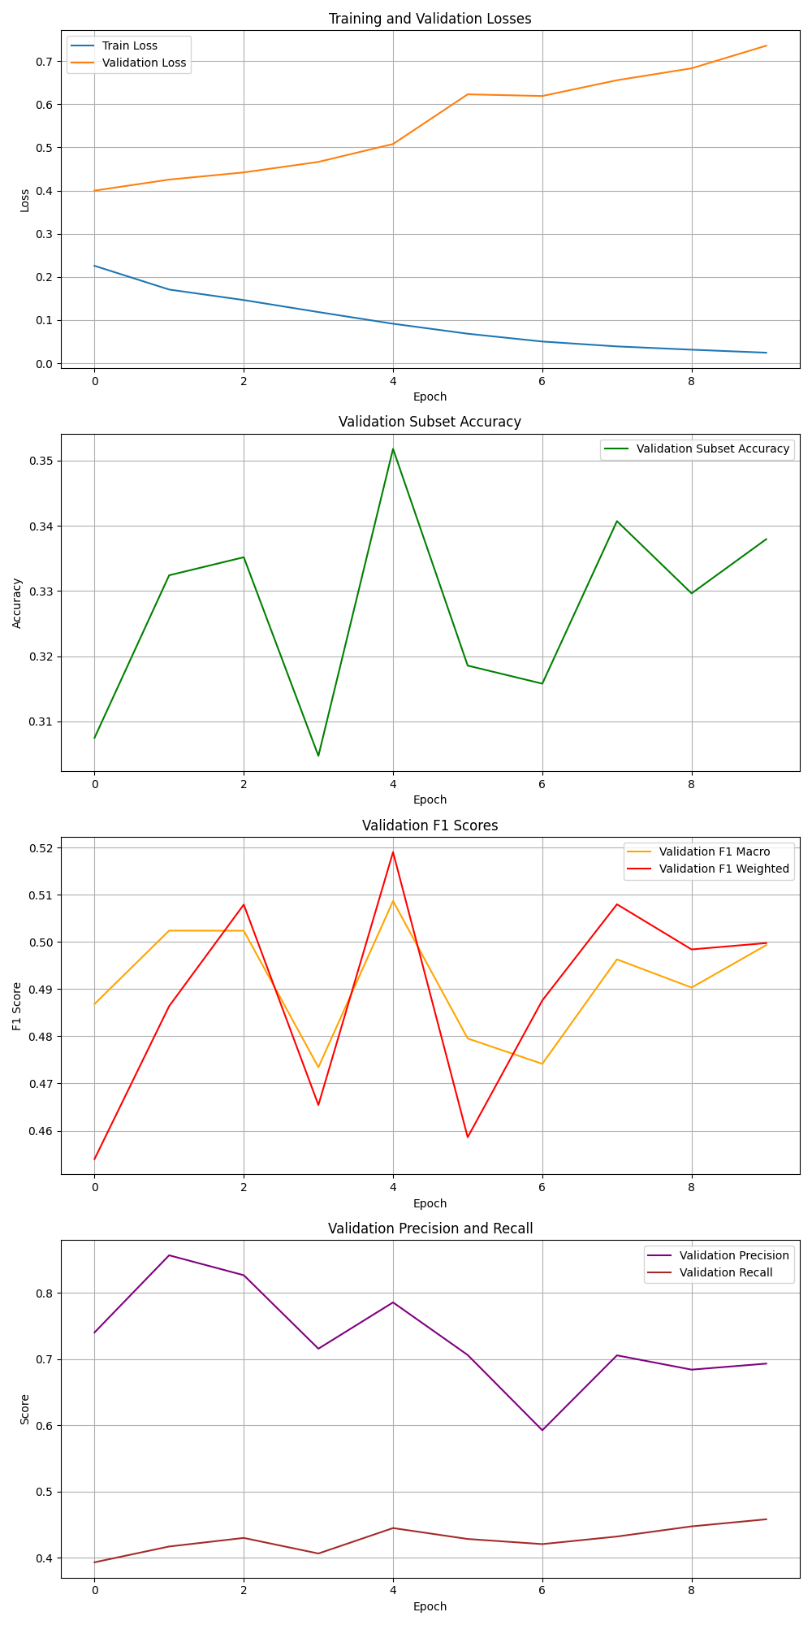
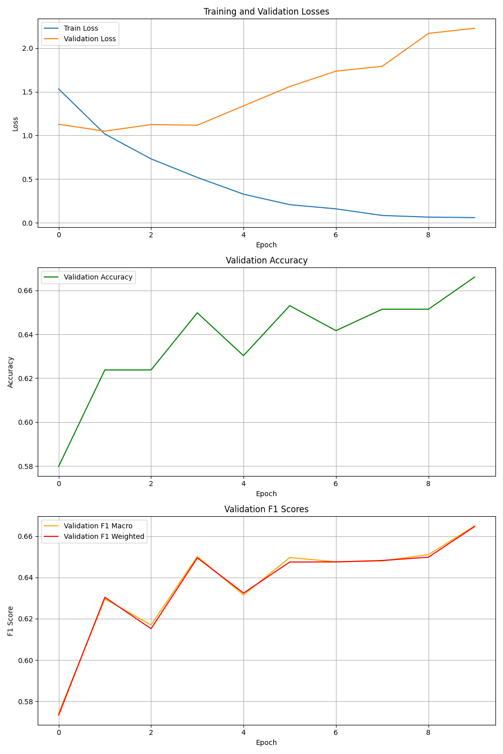
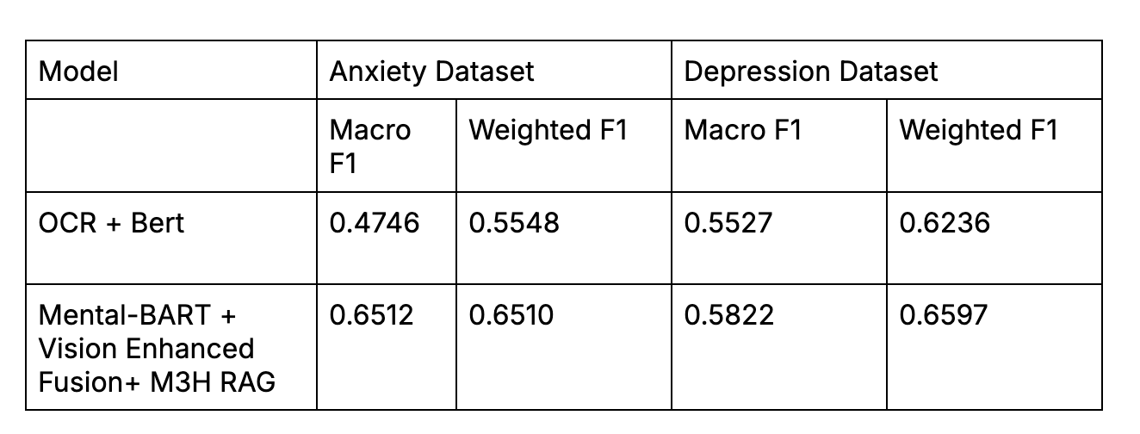
Training Outputs (M3H+VisFuse)
Key Results:
Anxiety Dataset Performance:
  Mental-BART + Vision Enhanced Fusion + M3H RAG achieves 0.6512 Macro F1
  37% improvement over OCR + BERT baseline (0.4746)
  Consistent performance on both macro and weighted metrics
Depression Dataset Performance:
  Mental-BART + Vision Enhanced Fusion + M3H RAG achieves 0.6597 Weighted F1
  Notable improvement over baseline model 0.6236
  More stable performance across different depression symptom categories

Slide 6
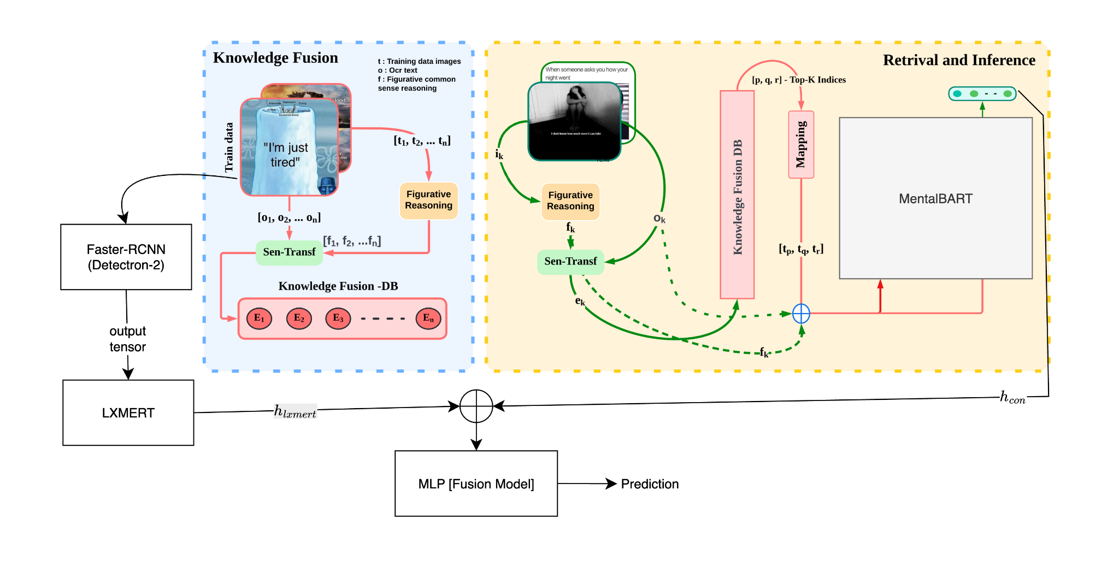
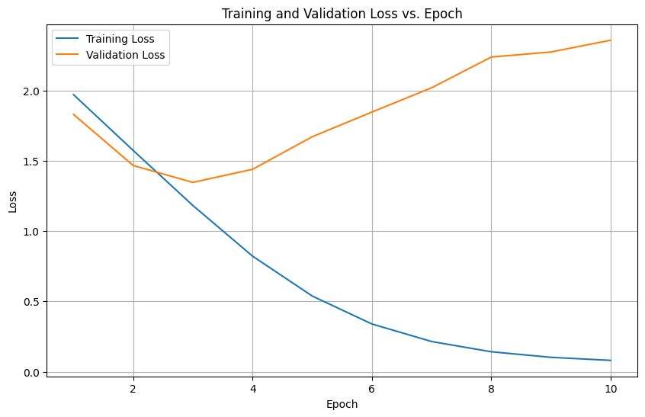
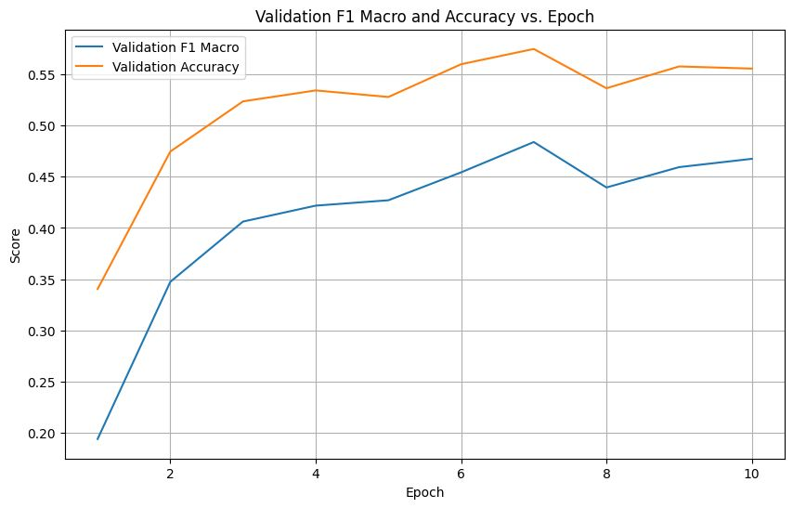
Another Approach : M3H+LXMERT
HyCore-M3Net is a hybrid multimodal model for classifying mental health symptoms in memes. It works by:
Processing Grounded Visuals+OCR: Using LXMERT to understand the relationship between the meme's visual region features (from an object detector) and its OCR text.
Processing Contextual Text: Using a MentalBART encoder to understand the meme's figurative reasoning (from Qwen-VL), augmented with retrieved context (OCR+Reasoning of similar examples found via RAG using a FAISS index built on fused embeddings).
Fusing Representations: Combining the outputs from LXMERT and MentalBART using concatenation and an MLP layer.
Classifying: Feeding the fused representation into a final classification head to predict symptom logits (supporting multi-label for depression and single-label for anxiety).
Ensembling: Typically training multiple instances and averaging predictions for robustness.
Notes:
HyCore-M3Net is a hybrid multimodal model for classifying mental health symptoms in memes. It works by:
Processing Grounded Visuals+OCR: Using LXMERT to understand the relationship between the meme's visual region features (from an object detector) and its OCR text.
Processing Contextual Text: Using a MentalBART encoder to understand the meme's figurative reasoning (from Qwen-VL), augmented with retrieved context (OCR+Reasoning of similar examples found via RAG using a FAISS index built on fused embeddings).
Fusing Representations: Combining the outputs from LXMERT and MentalBART using concatenation and an MLP layer.
Classifying: Feeding the fused representation into a final classification head to predict symptom logits (supporting multi-label for depression and single-label for anxiety).
Ensembling: Typically training multiple instances and averaging predictions for robustness.

Slide 7
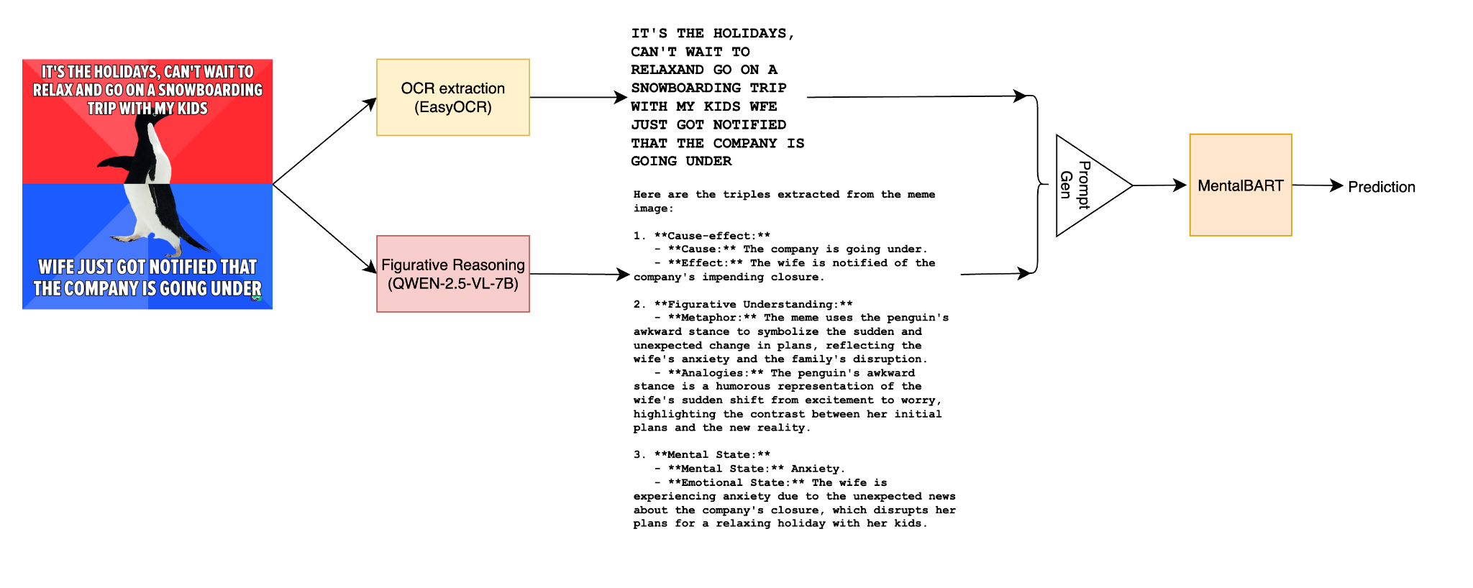

End to End inference example
Processing Steps:
Input Meme: A socially anxious penguin meme with contrasting red/blue backgrounds
OCR Extraction: Successfully identifies text "IT'S THE HOLIDAYS. CAN I HELP..." and "WHY JUST GOT NOTIFIED THAT THE COMPANY IS GOING UNDER"
Figurative Reasoning: Analyzes the implicit meaning behind the meme, extracting:
  Cause-Effect: The holiday season creating unexpected stressors
  Figurative Understanding: The contrasting emotions between social obligation and anxiety
  Mental State: Feelings of panic, helplessness, and social anxiety triggered by workplace uncertainty

